Slide 1
Arrays

Slide 2
Arrays
If the user want to store marks of 100 students. This can be done by creating 100 variable individually.
This process is rather tedious and impracticable.
An array is a sequence of data item of homogeneous value(same data type).
Arrays are of three types:
One-dimensional arrays
Two-dimensional arrays
Multidimensional arrays

Slide 3
Declaration of one-dimensional array
Syntax:
data_type array_name[array_size];
For example: int age[5];
float average[10];
char name[15];

Slide 4

Initialization of one-dimensional array
Arrays can be initialized at declaration time
int age[5]={2,4,34,3,4};

Slide 6
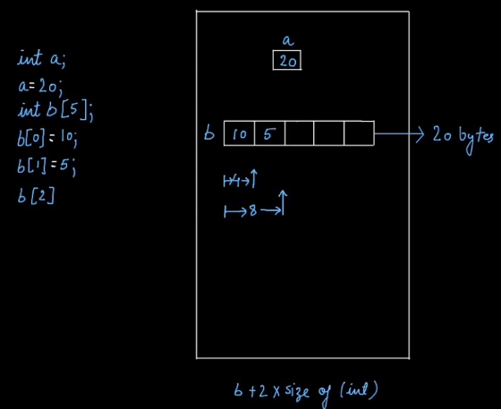

Slide 7
Accessing array elements
Statement to insert value in element of array
for(i=0;i<n;i++)
{
scanf("%d",&age[i]);
}
Statement to print the element of an array
for(i=0;i<n;i++)
{
printf(“Elements of array are%d",age[i]);
}

Slide 8
Program to take 5 values from the user and store them in an array and Print the elements stored in the array

Slide 9
#include <stdio.h>
int main() {
int values[5];
printf("Enter 5 integers: ");
// taking input and storing it in an array
for(int i = 0; i < 5; ++i) {
scanf("%d", &values[i]);
}
printf("Displaying integers: ");
// printing elements of an array
for(int i = 0; i < 5; ++i) {
printf("%d\n", values[i]);
}
return 0;
}

Slide 10
Example: To find the sum and average marks of n students using arrays
#include <stdio.h>
int main()
{
int marks[10],i,n,sum=0;
float average;
printf("Enter number of subjects: ");
scanf("%d",&n);
for(i=0;i<n;i++)
{
printf("Enter marks of individual subjects: “);
scanf("%d",&marks[i]);
sum=sum+marks[i];
}
average=sum/n;
printf("Sum= %d",sum);
printf(“Average= %f",average);
return 0;
}

Slide 11
Assessment
Write a C program Sort array in ascending order.

Slide 12
#include <stdio.h>
void main()
{
int i, j, a, n, number[30];
printf("Enter the value of \n");
scanf("%d", &n);
printf("Enter the numbers\n");
for (i = 0; i < n; ++i)
scanf("%d", &number[i]);
for (i = 0; i < n; ++i)
{
for (j = i + 1; j < n; ++j)
{
if (number[i] > number[j])
{
a = number[i];
number[i] = number[j];
number[j] = a;
}
}}
printf("The numbers arranged in ascending order are given below \n");
for (i = 0; i < n; ++i)
printf("%d\n", number[i]);
}

